Slide 1
Tailwind CSS

Slide 2
What is Tailwind CSS?
Tailwind CSS is a utility-first CSS framework designed to enable rapid and consistent development. Instead of writing custom CSS, you use pre-defined utility classes to style elements directly in your HTML or JSX.
Why use Tailwind?
Utility first approach
Highly Customizable
Speed & Efficiency
Consistent Design System
Built-in support for Mobile First
Responsive Design
Tailwind CSS Docs

Slide 3
Sizing
Syntax
class=”w-{value}”
class=”h-{value}”
Fixed units
1 unit = 0.25 rem = 4px (default browser settings)
w-1 = width: 0.25rem;
w-2 = width: 0.5rem;
w-96 = width: 24rem;
Tailwind CSS: Width Tailwind CSS: Height

Slide 4
Relative & Viewport Units
Relative
w-1/2 - width: 50%;
w-1/4 - width: 25%;
w-full - width: 100%;
Viewport
w-screen - width: 100vw;
h-screen - height: 100hv;
Tailwind CSS: Width Tailwind CSS: Height

Slide 5
Colors
Syntax
class=”bg-{color}-{shade}”
class=”text-{color}-{shade}”
class=”bg-black bg-white text-black text white”
Tailwind CSS: Colors
Accessibility
Color Contrast Checker

Slide 6
Paddings & Margins
Syntax
class=”p-{value}”
class=”m-{value}”
1 unit = 0.25rem;
Tailwind CSS: Padding Tailwind CSS: Margin

Slide 7
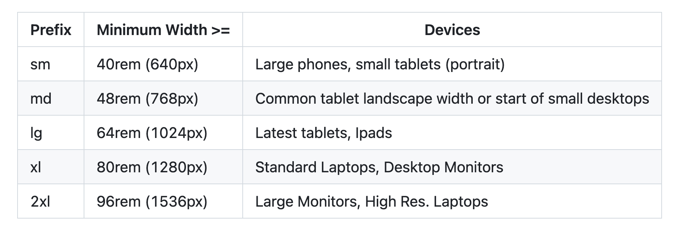
Responsive Design
Tailwind CSS: Responsive Design

Slide 8
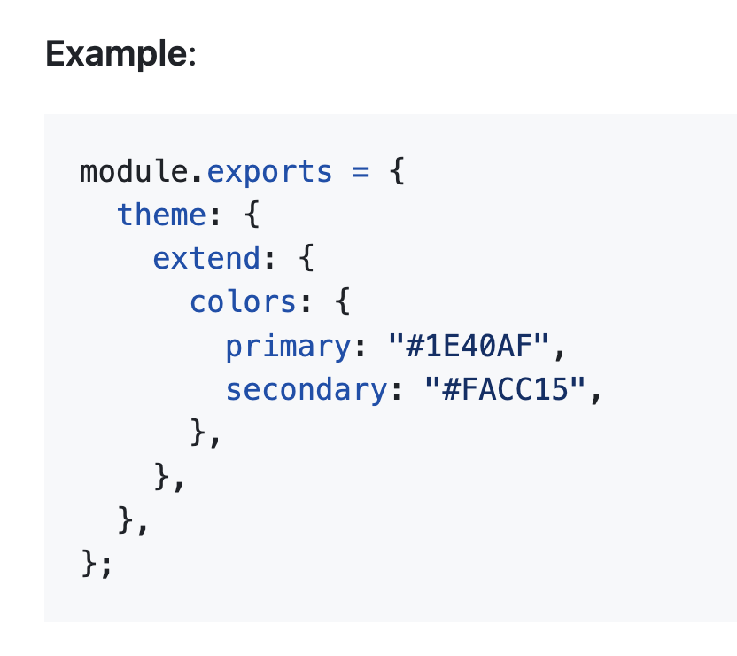
Configuration
Tailwind CSS: Configuration

Slide 9
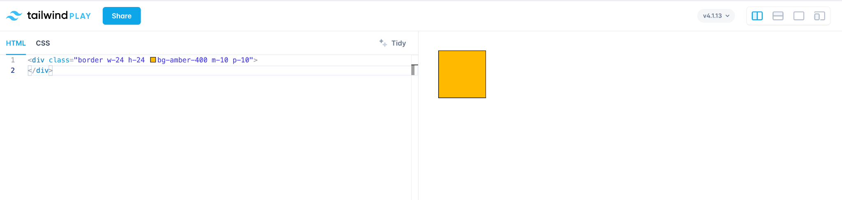
Playground
Playground

Slide 10
Installation
npm create vite@latest my-project
(creates react projet)
cd my-project
npm install tailwindcss @tailwindcss/vite
(installs tailwind dependencies)

Slide 11
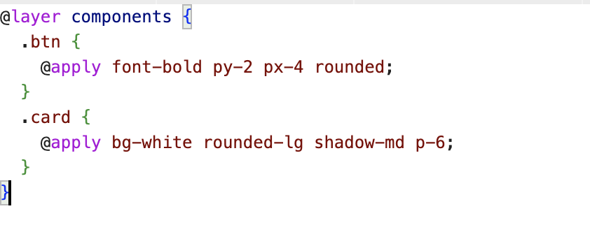
Directives
When installing tailwind into your project - add the @tailwind directives for each of tailwind layers to your main CSS file.
@tailwind base; - starting point - it injects base styles - collection of CSS resets and sensible defaults - ensures consistent look across different browsers
@tailwind components; - tailwind component classes - empty by default
@tailwind utilities; - all the utility classes we talked about (bg-black, p-0, flex, text-sm)
Example of using components layer:
Tailwind CSS: Directives

Slide 12
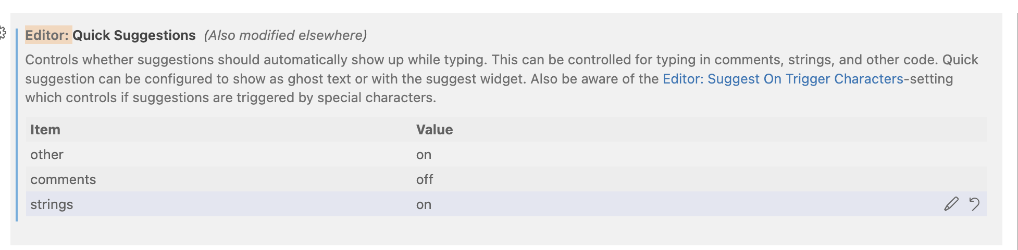
Useful tools
Tailwind CSS IntelliSense
Tailwind Fold
Tailwind Docs
Trick to improve IntelliSense in VSCode:
Navigate to VSCode settings > Quick Suggestions > Turn strings - from off to on

